Slide 1

Bioinformatics Bootcamp
Fall 2020: “Programming Fundamentals and RNA-Seq analysis”
Week 1: Orientation and R Data Structures

Slide 2
Workshop Orientation

Slide 3
Why a workshop?
Those who know bioinformatics will be…
More effective at research
More competitive for jobs/funding
More flexible/adaptable to changes in their field
There is tremendous interest in formal bioinformatics training... yet, opportunities for such training are sparse.
Solution: Provide training as a weekly workshop open to all!

Slide 4
Workshop Structure
Most sessions will be roughly 50:50 lecture and hands-on activities.

Slide 5
Workshop Structure
Most sessions will be roughly 50:50 lecture and hands-on activities.
***Lectures will be recorded***

Slide 6
Workshop Structure
Most sessions will be roughly 50:50 lecture and hands-on activities.
***Lectures will be recorded***
Outline
Part 1: Learn R programming (4 weeks)
Part 2: Downstream RNA-Seq analysis with R (4 weeks)
Part 3: Upstream RNA-Seq analysis with Linux shell (3 weeks)
Part 4: Workshop final project (2 weeks)

Slide 7
Learning goals and objectives
Gain fundamental R programming skills

Slide 8
Learning goals and objectives
Gain fundamental R programming skills
Learn to perform downstream RNA-Seq analysis with R

Slide 9
Learning goals and objectives
Gain fundamental R programming skills
Learn to perform downstream RNA-Seq analysis with R
Learn to perform upstream RNA-Seq analysis with Linux shell

Slide 10
Learning goals and objectives
Gain fundamental R programming skills
Learn to perform downstream RNA-Seq analysis with R
Learn to perform upstream RNA-Seq analysis with Linux shell
Learn to perform a complete RNA-Seq analysis and present it

Slide 11
Learning goals and objectives
Gain fundamental R programming skills
Learn to perform downstream RNA-Seq analysis with R
Learn to perform upstream RNA-Seq analysis with Linux shell
Learn to perform a complete RNA-Seq analysis and present it
By the end, you will gain the skills and confidence to use RNA-Seq analysis and R programming in your research.

Slide 12
How to succeed in this workshop
Put in the time/effort. Likely requirements:
Learning R: 15+ hours
RNA-Seq assignments: 10+ hours
Final project: 4+ hours

Slide 13
How to succeed in this workshop
Put in the time/effort. Likely requirements:
Learning R: 15+ hours
RNA-Seq assignments: 10+ hours
Final project: 4+ hours
DataCamp Classroom
Do the assignments
Do the assessments
Do the practice questions every day

Slide 14
How to succeed in this workshop
Put in the time/effort. Likely requirements:
Learning R: 15+ hours
RNA-Seq assignments: 10+ hours
Final project: 4+ hours
DataCamp Classroom
Do the assignments
Do the assessments
Do the practice questions every day
Pursue outside learning (e.g., codecademy, RStudio books, etc)

Slide 15
How to succeed in this workshop
Put in the time/effort. Likely requirements:
Learning R: 15+ hours
RNA-Seq assignments: 10+ hours
Final project: 4+ hours
DataCamp Classroom
Do the assignments
Do the assessments
Do the practice questions every day
Pursue outside learning (e.g., codecademy, RStudio books, etc)
Communicate with your instructors
Email any time and attend Zoom office hours

Slide 16





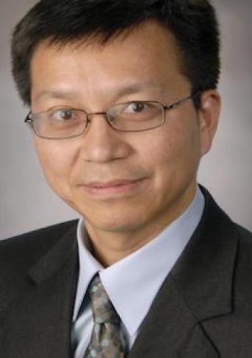


Bioinformatics Bootcamp Instructors
Student Instructors and TAs
Henry Miller
Victoria Alers
Paul Ramirez
Muku Bhandari
Faculty and Staff instructors
Dr. Chris Chiu
Dr. Yidong Chen
Dr. Siyuan Zheng
Dr. Evelien Bunnik

Slide 17

About BIG club
Bioinformatics Interest Group (BIG) is a new UT Health SA club promoting student engagement with bioinformatics.
Leadership
President: Muku Bhandari
Vice President: Victoria Alers
Secretary: Paul Ramirez
Training committee chair: Henry Miller
All UT Health SA students are welcome to join our first meeting next Tuesday Sept 8th from 6:30-7:30pm.
* We have two officer positions available and will be holding elections at the next meeting

Slide 18
Introduction to Bioinformatics and R

Slide 19
What is bioinformatics?
Data Science
Comp. Science
Statistics
Bioinformatics
Comp. Biology
Biostatistics
Biology

Slide 20
Bioinformatics can be defined as…
“the application of computational tools to organize, analyze, understand, visualize and store information associated with biological macromolecules”
Bilotta, M., Tradigo, G. & Veltri, P. Bioinformatics Data Models, Representation and Storage. in (eds. Ranganathan, S., Gribskov, M., Nakai, K. & Schönbach, C. B. T.-E. of B. and C. B.) 110–116 (Academic Press, 2019). doi:https://doi.org/10.1016/B978-0-12-809633-8.20410-X.

Slide 21
What is bioinformatics used for?
Analyzing sequencing data

Slide 22
What is bioinformatics used for?
Analyzing sequencing data
Mining public literature

Slide 23
What is bioinformatics used for?
Analyzing sequencing data
Mining public literature
Generating new hypotheses

Slide 24
What is bioinformatics used for?
Analyzing sequencing data
Mining public literature
Generating new hypotheses
Constructing models of biological systems

Slide 25
What is bioinformatics used for?
Analyzing sequencing data
Mining public literature
Generating new hypotheses
Constructing models of biological systems
Organizing laboratory data into a report

Slide 26
What is bioinformatics used for?
Analyzing sequencing data
Mining public literature
Generating new hypotheses
Constructing models of biological systems
Organizing laboratory data into a report
Performing statistical analyses and making figures

Slide 27
What is bioinformatics used for?
Analyzing sequencing data
Mining public literature
Generating new hypotheses
Constructing models of biological systems
Organizing laboratory data into a report
Performing statistical analyses and making figures
Testing existing hypotheses

Slide 28
What is bioinformatics used for?
Analyzing sequencing data
Mining public literature
Generating new hypotheses
Constructing models of biological systems
Organizing laboratory data into a report
Performing statistical analyses and making figures
Testing existing hypotheses
Etc…

Slide 29
What is bioinformatics used for?
Analyzing sequencing data
Mining public literature
Generating new hypotheses
Constructing models of biological systems
Organizing laboratory data into a report
Performing statistical analyses and making figures
Testing existing hypotheses
Etc…

Slide 30
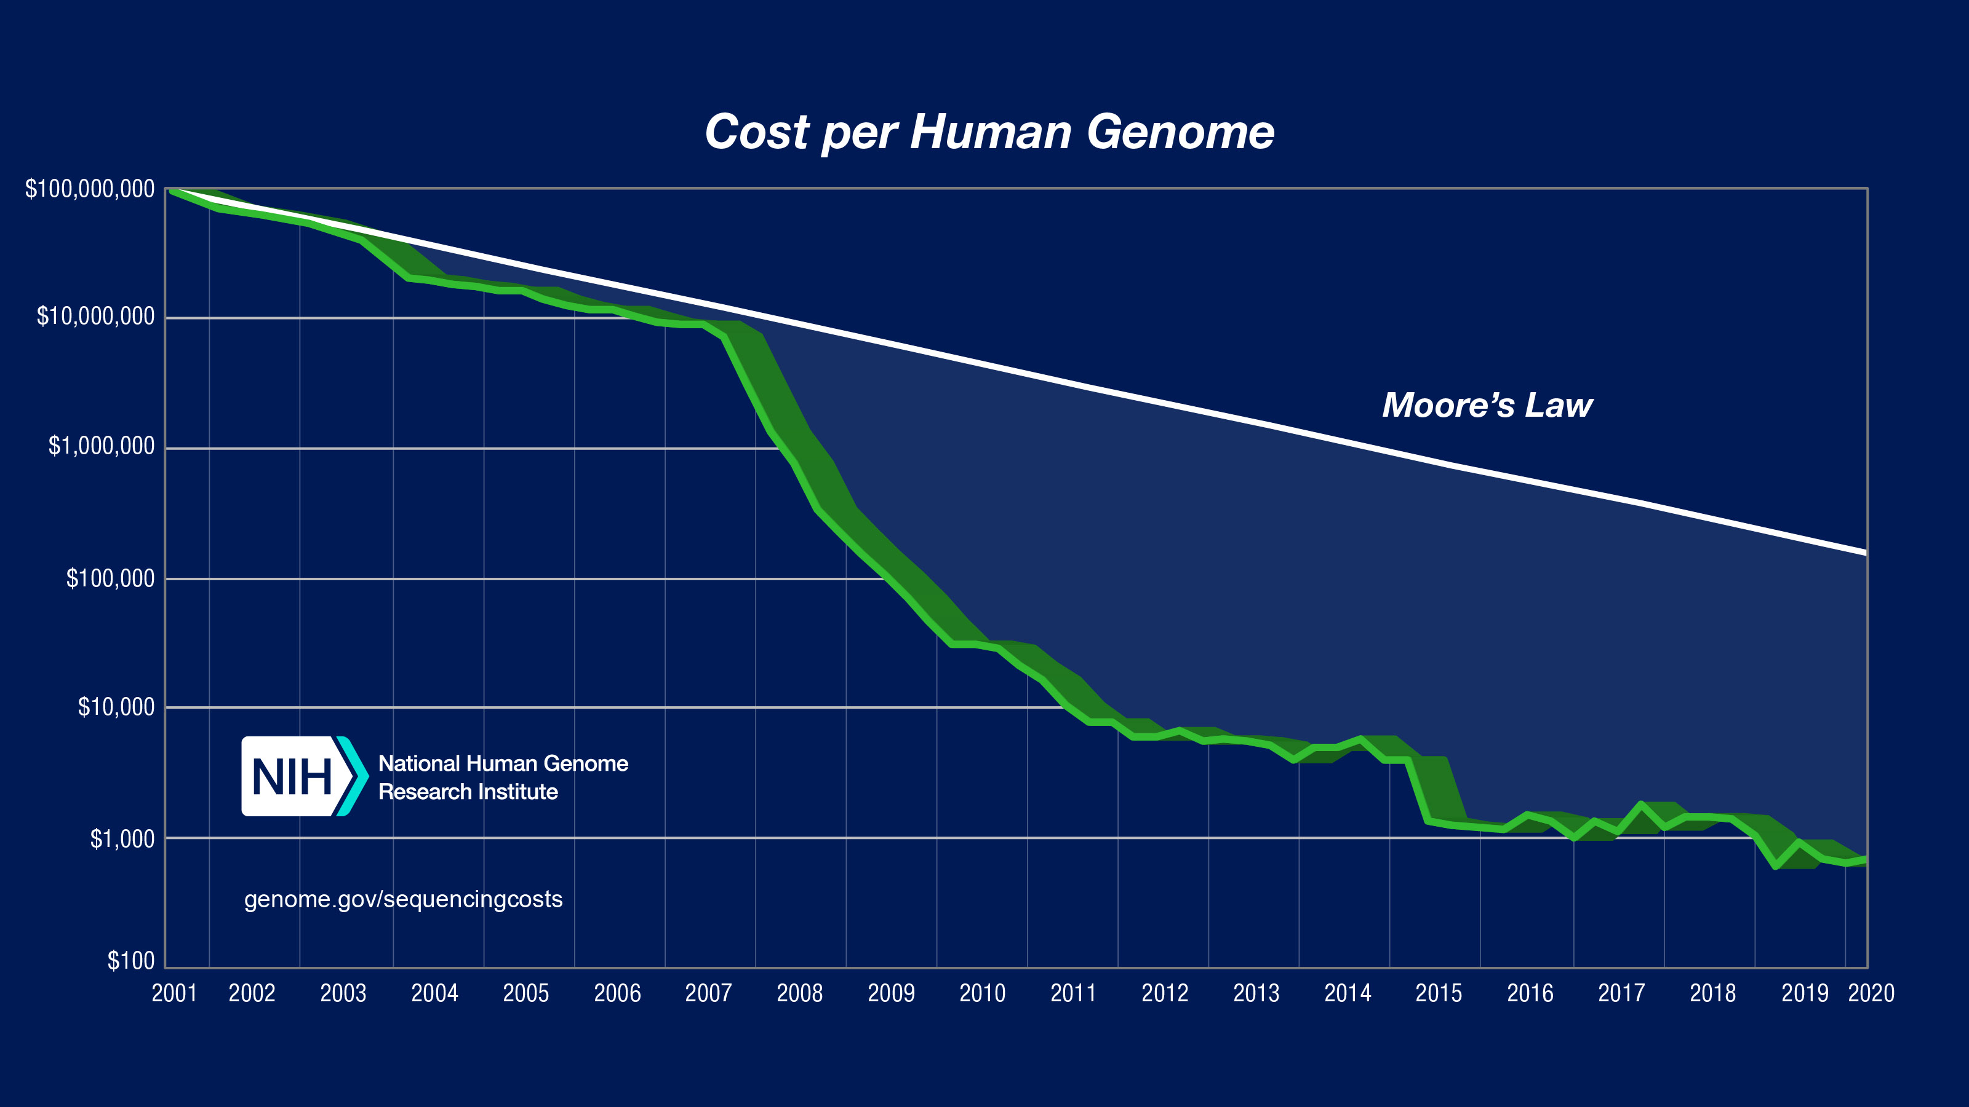
Bioinformatics is open source science
https://www.ncbi.nlm.nih.gov/sra/docs/sragrowth/

Slide 31
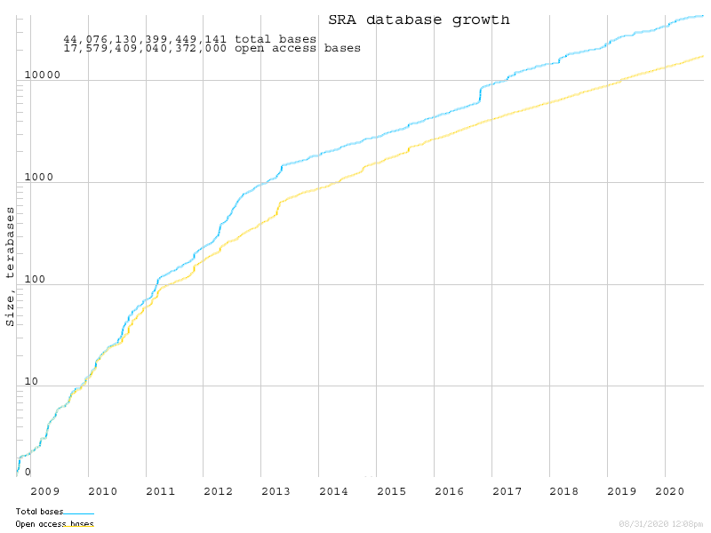
Bioinformatics is open source science
> 11 PB of data!
Log scale…
https://www.ncbi.nlm.nih.gov/sra/docs/sragrowth/

Slide 32
Bioinformatics is open source science
Thousands of public databases

Slide 33
Bioinformatics is open source science
Thousands of public databases
Millions of data samples freely available

Slide 34
Bioinformatics is open source science
Thousands of public databases
Millions of data samples freely available
Code is (usually) freely available

Slide 35
Bioinformatics is open source science
Thousands of public databases
Millions of data samples freely available
Code is (usually) freely available
Training resources are (often) freely available

Slide 36
Bioinformatics is open source science
Thousands of public databases
Millions of data samples freely available
Code is (usually) freely available
Training resources are (often) freely available
Result: Bioinformatics is only becoming bigger and more useful every year because it is (largely) open source

Slide 37
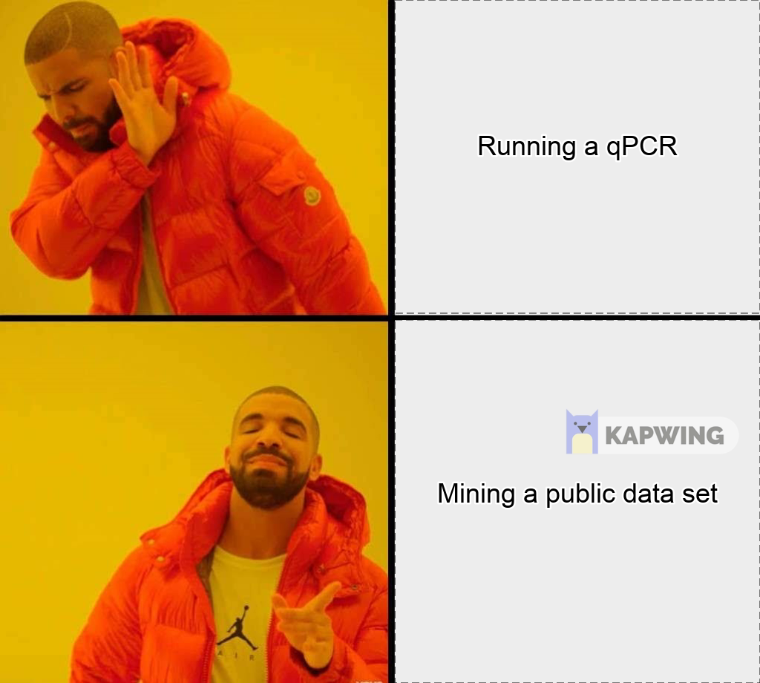
Implications of Open Source Bioinformatics…
Running a qPCR
Mining some public RNA-Seq data

Slide 38
Question: Does cisplatin cause a decrease in NRP1 expression?
Interactive Example

Slide 39

What is R?
Programming language first released in 1995
Open-source derivative of Bell Lab’s “S” language
Features:
Object oriented
Interpreted (not compiled!)
Designed for statistical computing
Easily extended with packages
https://www.r-project.org/

Slide 40
What is R?
Coding demo

Slide 41
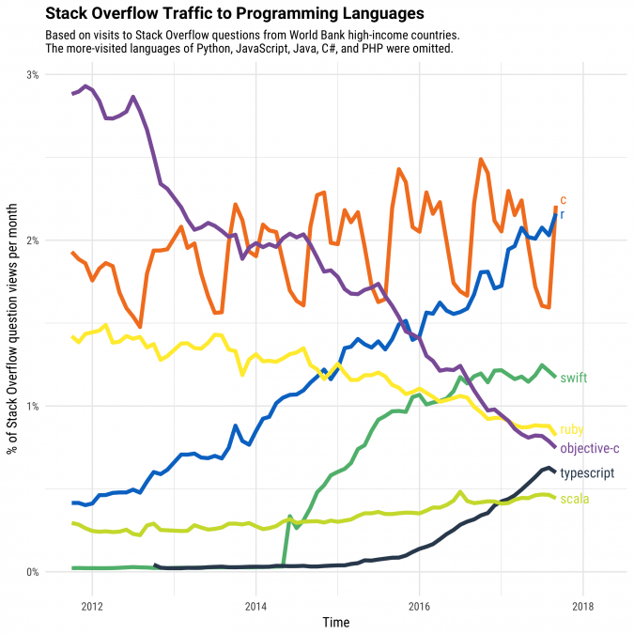
Why learn R?
Up-and-coming language for Data Science
https://stackoverflow.blog/2017/10/10/impressive-growth-r/

Slide 42
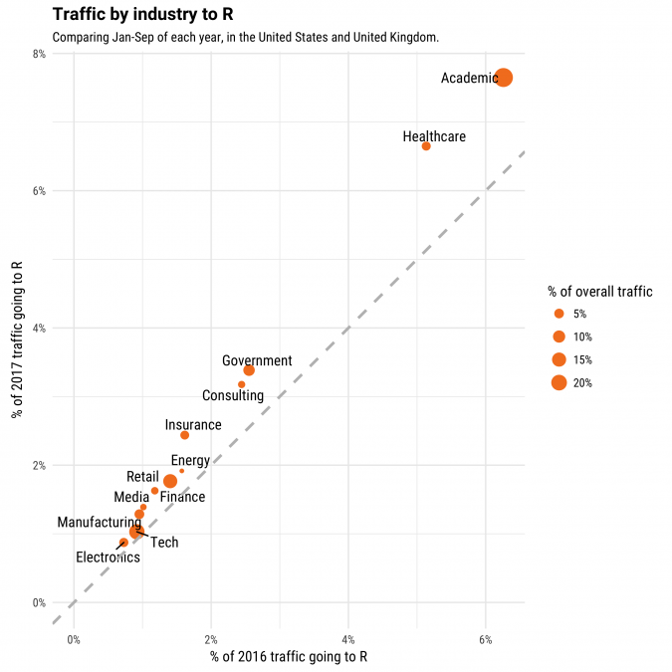
Why learn R?
Academic research is the largest area of R usage
https://stackoverflow.blog/2017/10/10/impressive-growth-r/

Slide 43

R-based Bioconductor is the leading repository of bioinformatics software
https://blog.f1000.com/2016/07/14/going-with-the-workflow-an-interview-with-bioconductor/

Slide 44
R-based Bioconductor is the leading repository of bioinformatics software
Question: Is the popularity of Bioconductor increasing over time?
read_tsv("https://bioconductor.org/packages/stats/bioc/bioc_pkg_stats.tab") %>% filter(Year != 2020) %>% select(Year, Nb_of_downloads) %>% group_by(Year) %>% summarise(sum = sum(Nb_of_downloads)) %>% ggplot(mapping = aes(x = Year, y = sum)) + geom_path() + scale_x_continuous(breaks = 2009:2019) + theme_classic(base_size = 18) + labs(x = NULL, y = "Downloads", title = "Bioconductor package downloads over time")

Slide 45
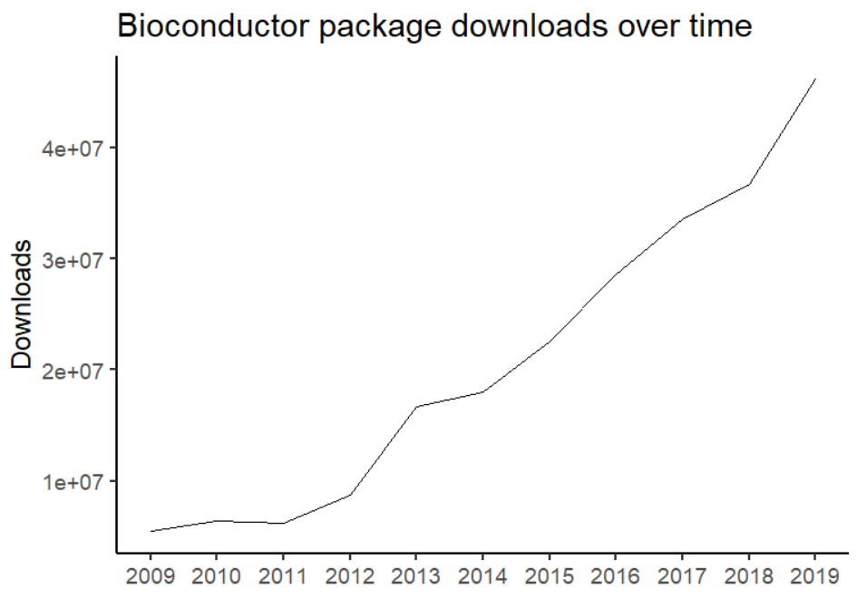
R-based Bioconductor is the leading repository of bioinformatics software

Slide 46


Fine alternatives to R exist
https://juniortech.org/wp-content/uploads/2017/04/python-software-logo.jpg
https://eps.leeds.ac.uk/events/event///5932/how-can-matlab-help-research-workflows

Slide 47
Setting up R

Slide 48
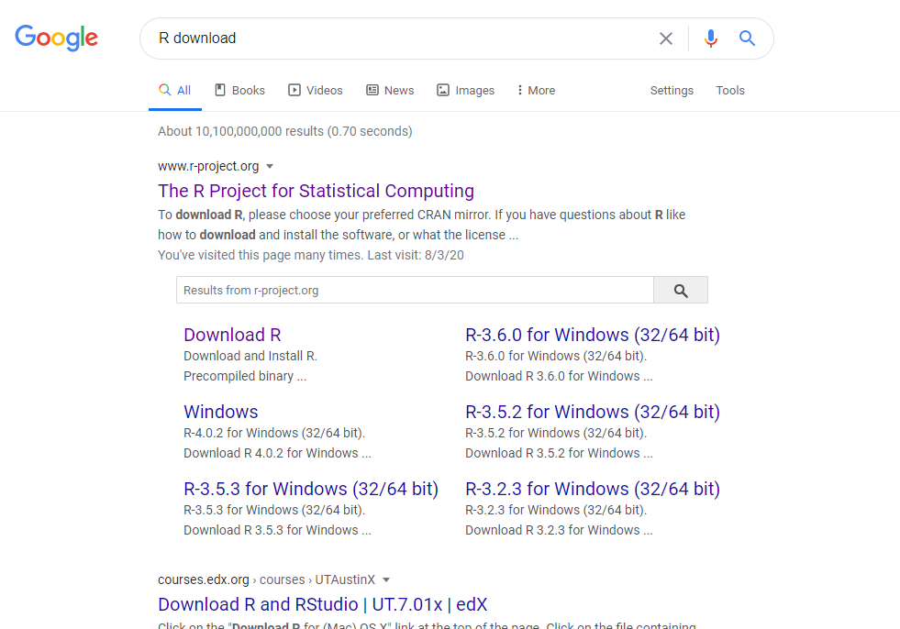

Slide 49
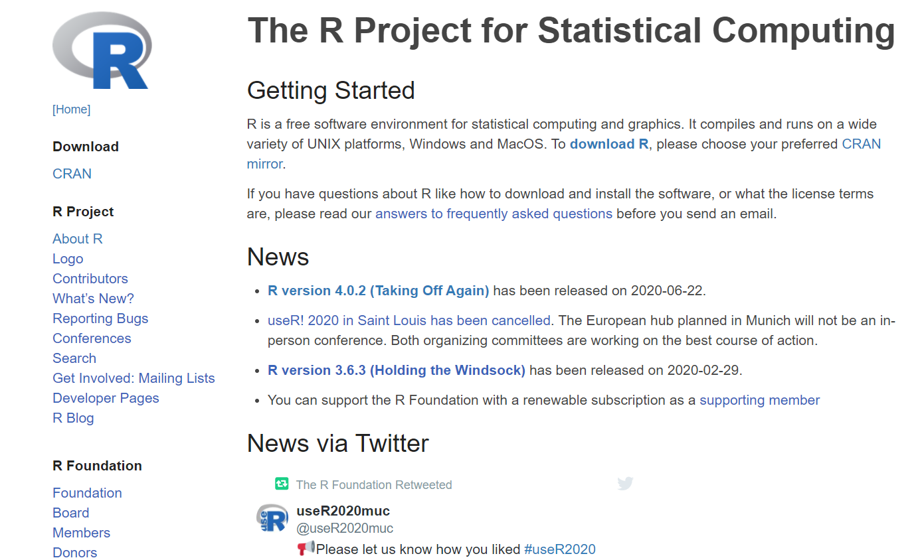

Slide 50
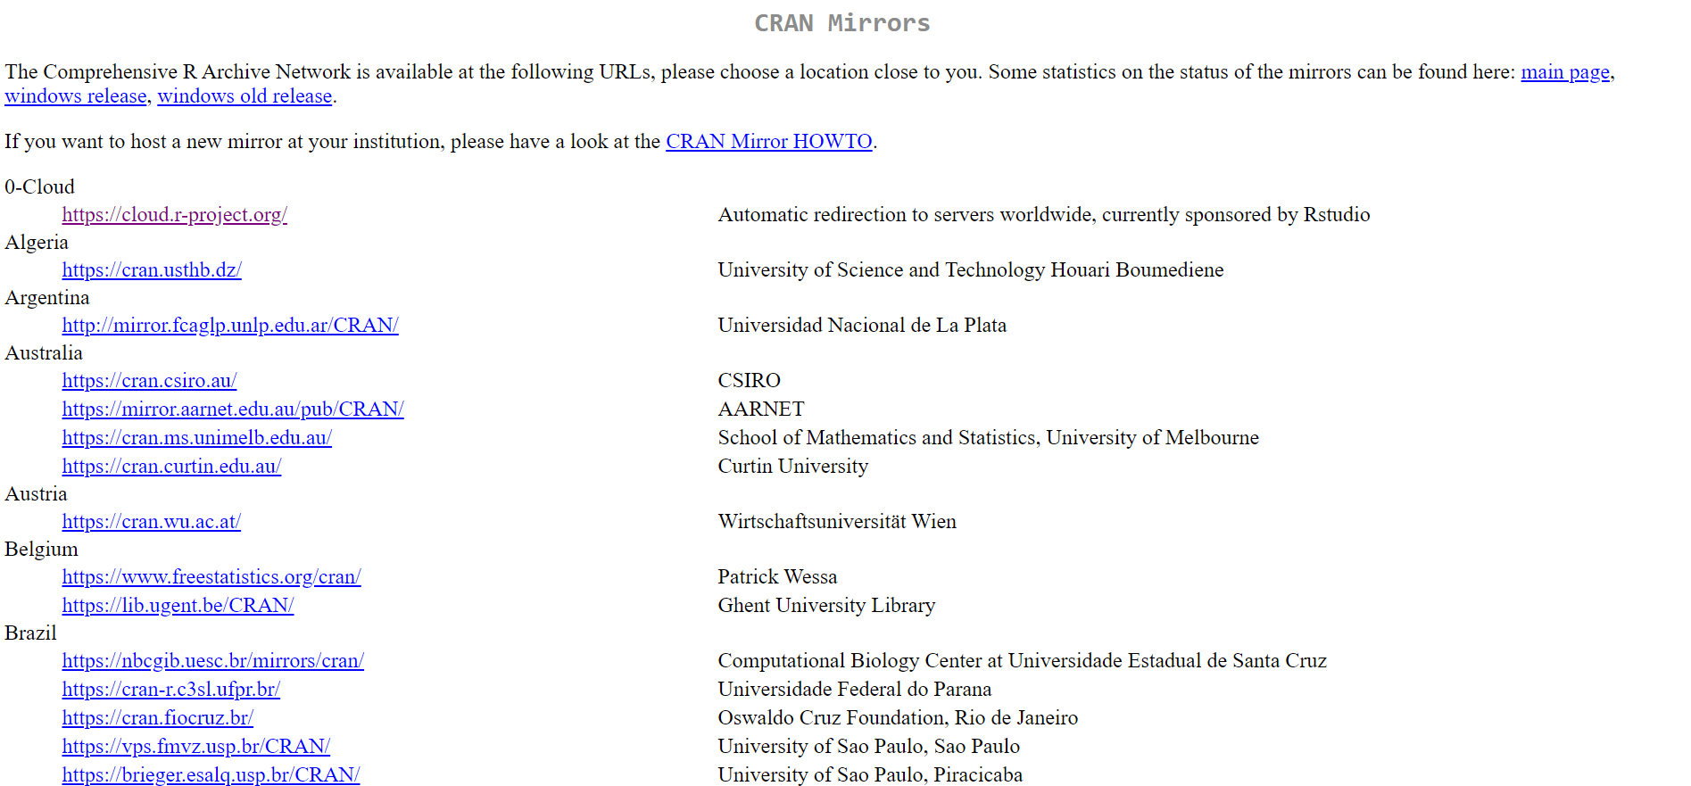

Slide 51
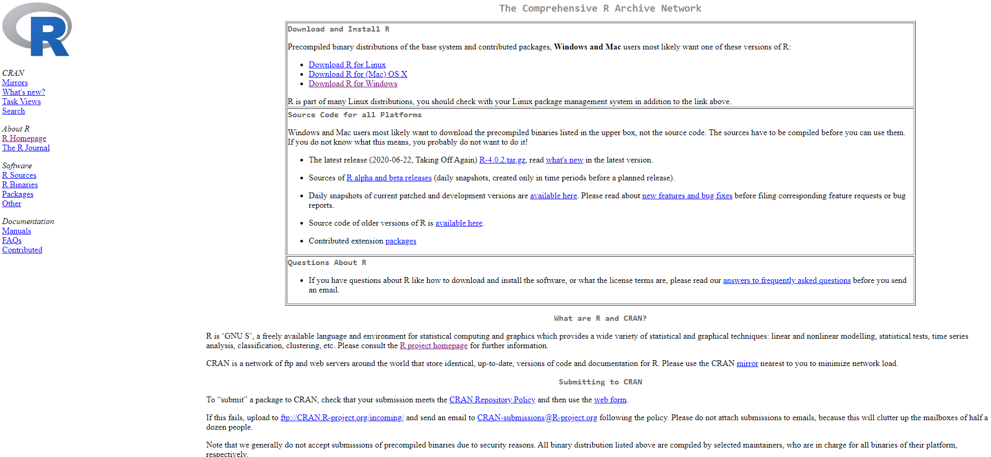

Slide 52
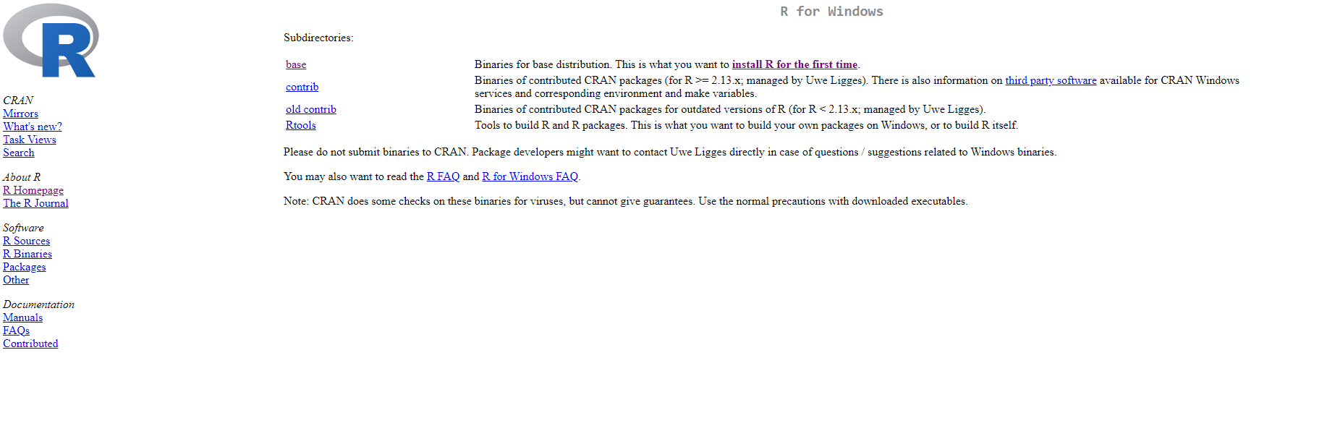

Slide 53
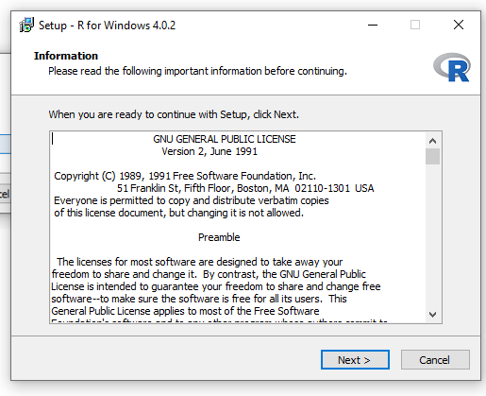

Slide 54
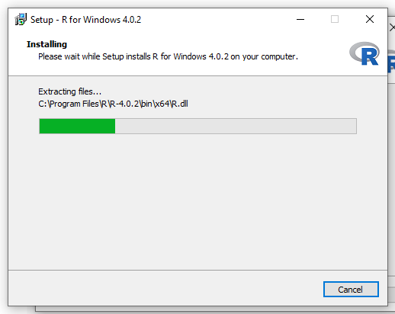

Slide 55
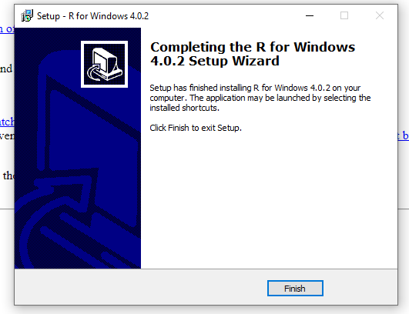

Slide 56
Setting up RStudio

Slide 57
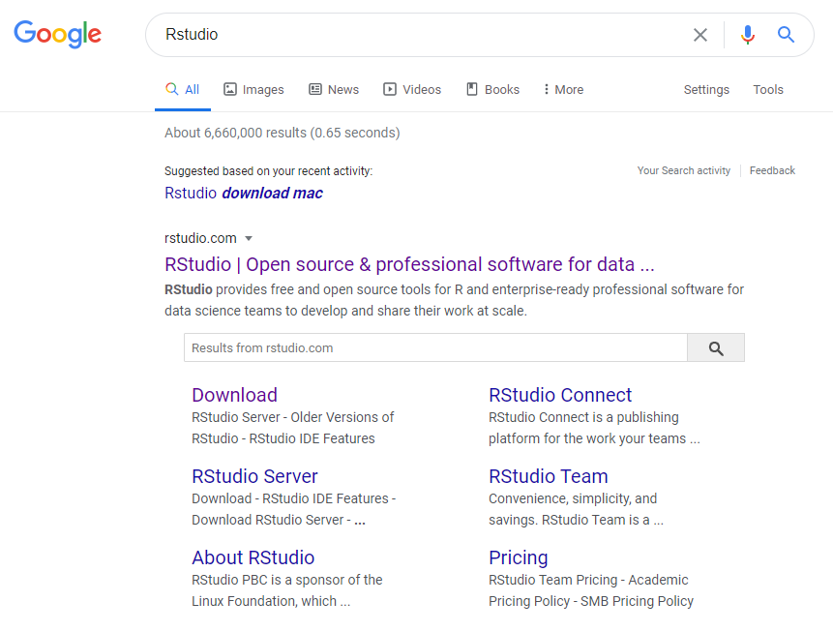

Slide 58


Slide 59


Slide 60
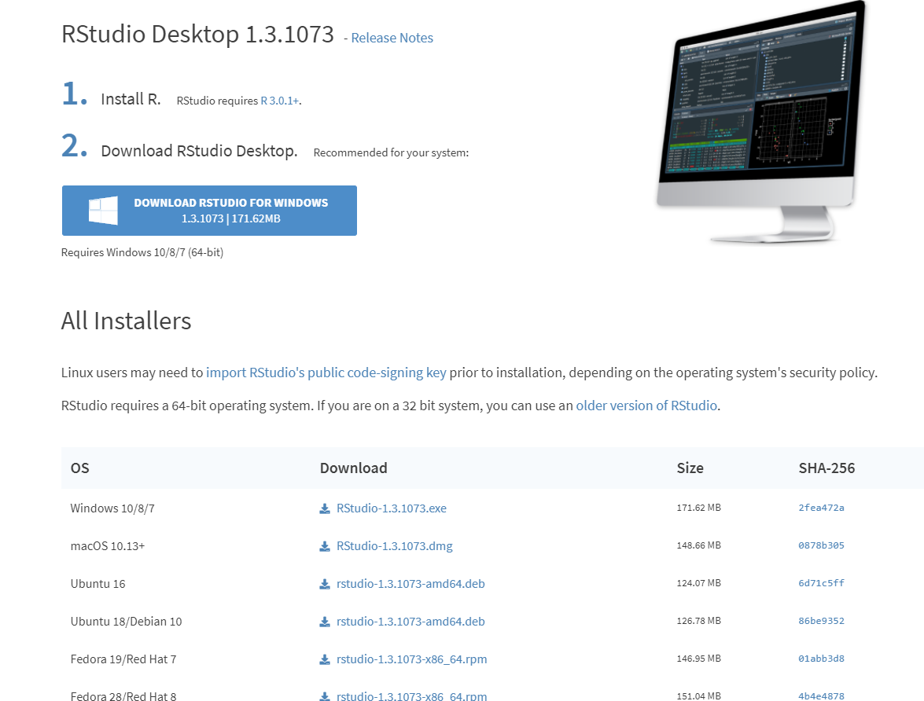

Slide 61
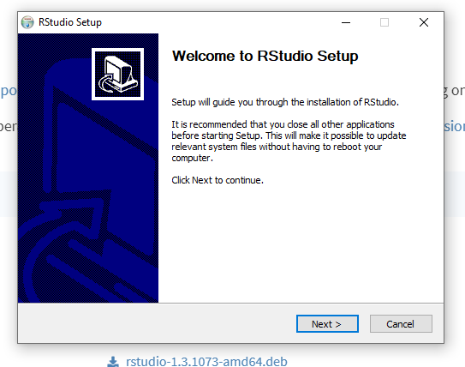

Slide 62
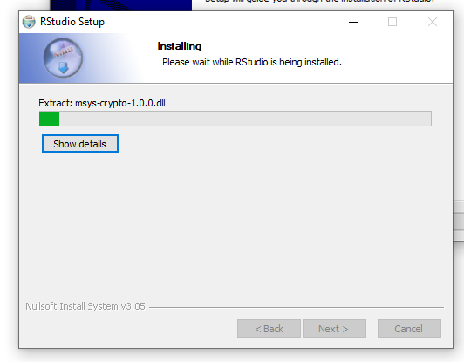

Slide 63
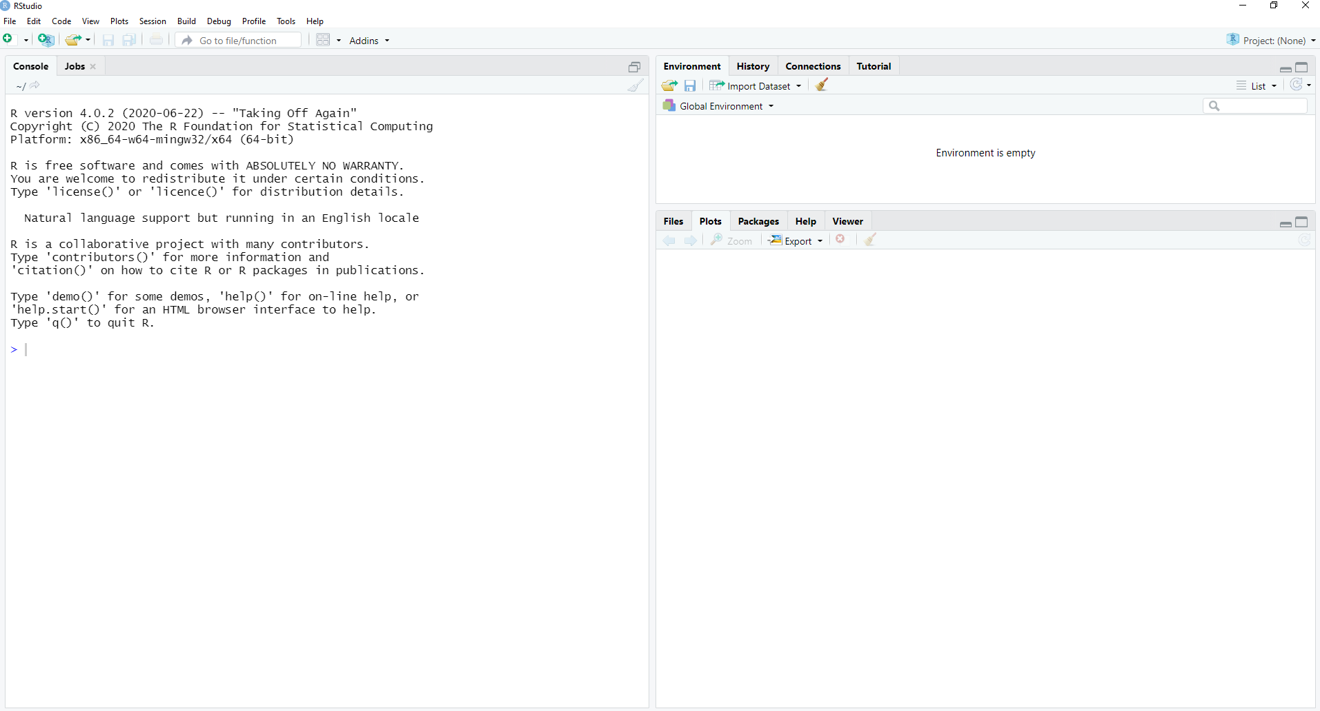

Slide 64
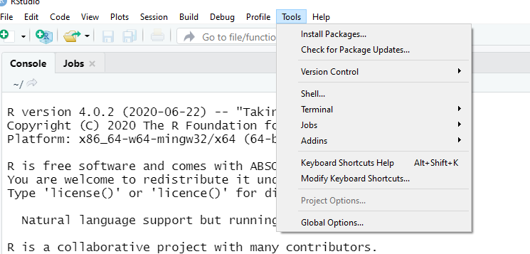

Slide 65
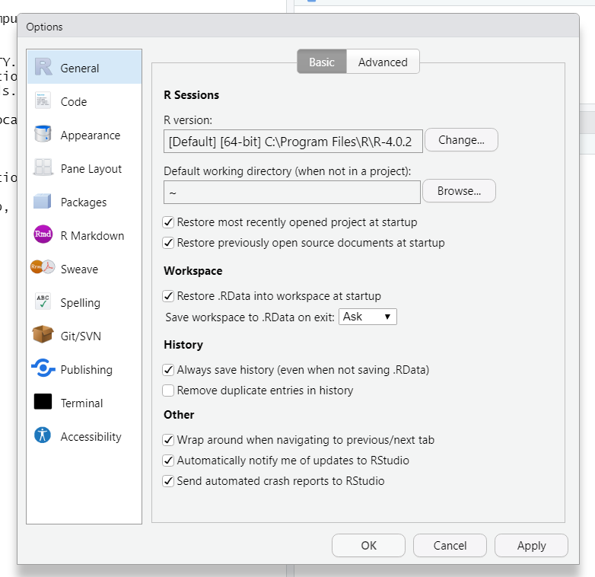

Slide 66
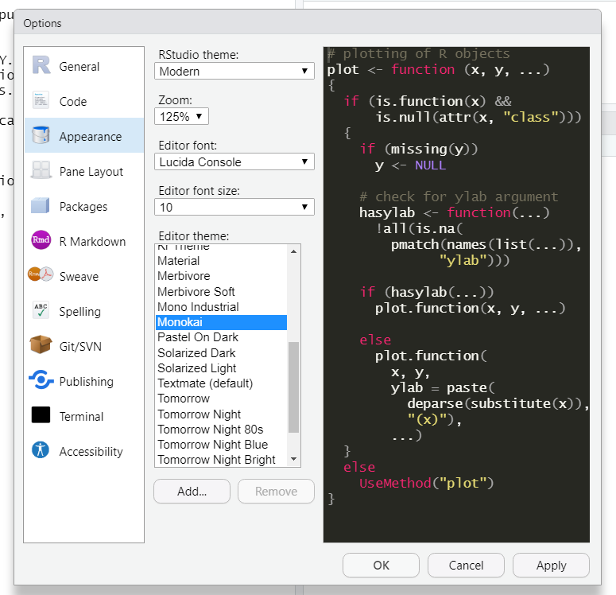

Slide 67
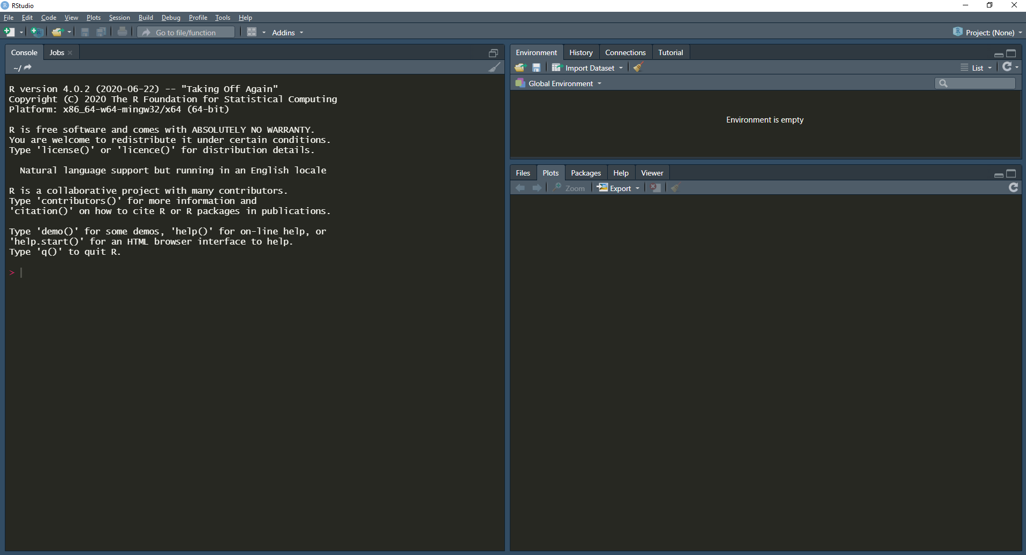

Slide 68
Data Structures in R
Week 1 Formal Lecture

Slide 69
Simple Data Structures

Slide 70
Characters
Characters hold “string” data. For example:
"Hello world"

Slide 71
Characters
Characters hold “string” data. For example:
"Hello world"
## [1] "Hello world"

Slide 72
Numbers
Numbers can be integers or numerics (i.e., floats) in R. For example:
1

Slide 73
Numbers
Numbers can be integers or numerics (i.e., floats) in R. For example:
1
## [1] 1

Slide 74
Numbers
Numbers can be integers or numerics (i.e., floats) in R. For example:
1
## [1] 1
2.2
## [1] 2.2

Slide 75
Numbers
Numbers can be integers or numerics (i.e., floats) in R. For example:
1
## [1] 1
2.2
## [1] 2.2
3E100
## [1] 3e+100

Slide 76
Logicals
Logicals are either TRUE or FALSE. For example:
TRUE
## [1] TRUE
FALSE
## [1] FALSE

Slide 77
Data Structure Classes
We can identify the “type” or “class” of an object in R with the class function:
class(1)

Slide 78
Data Structure Classes
We can identify the “type” or “class” of an object in R with the class function:
class(1)
## [1] "numeric"

Slide 79
Data Structure Classes
We can identify the “type” or “class” of an object in R with the class function:
class(1)
## [1] "numeric"
class("Hello World!")

Slide 80
Data Structure Classes
We can identify the “type” or “class” of an object in R with the class function:
class(1)
## [1] "numeric"
class("Hello World!")
## [1] "character"

Slide 81
Data Structure Classes
We can identify the “type” or “class” of an object in R with the class function:
class(1)
## [1] "numeric"
class("Hello World!")
## [1] "character"
class(TRUE)

Slide 82
Data Structure Classes
We can identify the “type” or “class” of an object in R with the class function:
class(1)
## [1] "numeric"
class("Hello World!")
## [1] "character"
class(TRUE)
## [1] "logical"

Slide 83
Data Structure Classes cont.
We can also use the str function to see the “structure” of any R object:
str(1)

Slide 84
Data Structure Classes cont.
We can also use the str function to see the “structure” of any R object:
str(1)
## num 1

Slide 85
Data Structure Classes cont.
We can also use the str function to see the “structure” of any R object:
str(1)
## num 1
str("Hello World!")

Slide 86
Data Structure Classes cont.
We can also use the str function to see the “structure” of any R object:
str(1)
## num 1
str("Hello World!")
## chr "Hello World!"

Slide 87
Data Structure Classes cont.
We can also use the str function to see the “structure” of any R object:
str(1)
## num 1
str("Hello World!")
## chr "Hello World!"
str(TRUE)

Slide 88
Data Structure Classes cont.
We can also use the str function to see the “structure” of any R object:
str(1)
## num 1
str("Hello World!")
## chr "Hello World!"
str(TRUE)
## logi TRUE

Slide 89
Comments
An important tool for writing R code is comments. These are preceded by # and are ignored by R.
# This code will say "Hello World!" "Hello world!"
## [1] "Hello world!"
Comments are a helpful tool for conveying information about your code to others.

Slide 90
Simple Data Structure Methods

Slide 91
Arithmetic Methods
Arithmetic Methods for numeric data types:
# Addition 1 + 1
## [1] 2
# Subtraction 1 - 1
## [1] 0
# Multiplication 2 * 2
## [1] 4
# Division 10 / 2
## [1] 5

Slide 92
Equivalence Comparisons
Equivalence comparisons are a way to check if any two objects are the same.
# Does 1 equal 1? 1 == 1

Slide 93
Equivalence Comparisons
Equivalence comparisons are a way to check if any two objects are the same.
# Does 1 equal 1? 1 == 1
## [1] TRUE

Slide 94
Equivalence Comparisons
Equivalence comparisons are a way to check if any two objects are the same.
# Does 1 equal 1? 1 == 1
## [1] TRUE
# Does "Hello" equal "World"? "Hello" == "World"

Slide 95
Equivalence Comparisons
Equivalence comparisons are a way to check if any two objects are the same.
# Does 1 equal 1? 1 == 1
## [1] TRUE
# Does "Hello" equal "World"? "Hello" == "World"
## [1] FALSE

Slide 96
Equivalence Comparisons cont.
Equivalence comparisons can be inverted to check if two objects are not equal.
# Does 1 not equal 1? 1 != 1

Slide 97
Equivalence Comparisons cont.
Equivalence comparisons can be inverted to check if two objects are not equal.
# Does 1 not equal 1? 1 != 1
## [1] FALSE

Slide 98
Equivalence Comparisons cont.
Equivalence comparisons can be inverted to check if two objects are not equal.
# Does 1 not equal 1? 1 != 1
## [1] FALSE
# Does "Hello" not equal "World"? "Hello" != "World"

Slide 99
Equivalence Comparisons cont.
Equivalence comparisons can be inverted to check if two objects are not equal.
# Does 1 not equal 1? 1 != 1
## [1] FALSE
# Does "Hello" not equal "World"? "Hello" != "World"
## [1] TRUE

Slide 100
Mathematical Comparisons
For numeric data types, mathematical comparisons can also be made.
# Is 1 less than 100? 1 < 100

Slide 101
Mathematical Comparisons
For numeric data types, mathematical comparisons can also be made.
# Is 1 less than 100? 1 < 100
## [1] TRUE

Slide 102
Mathematical Comparisons
For numeric data types, mathematical comparisons can also be made.
# Is 1 less than 100? 1 < 100
## [1] TRUE
# Is 2 + 2 greater than 2 ^ 2? 2 + 2 > 2 ^ 2

Slide 103
Mathematical Comparisons
For numeric data types, mathematical comparisons can also be made.
# Is 1 less than 100? 1 < 100
## [1] TRUE
# Is 2 + 2 greater than 2 ^ 2? 2 + 2 > 2 ^ 2
## [1] FALSE

Slide 104
Mathematical Comparisons
For numeric data types, mathematical comparisons can also be made.
# Is 1 less than 100? 1 < 100
## [1] TRUE
# Is 2 + 2 greater than 2 ^ 2? 2 + 2 > 2 ^ 2
## [1] FALSE
# Is 2 + 2 greater than or equal to 2 ^ 2? 2 + 2 >= 2 ^ 2

Slide 105
Mathematical Comparisons
For numeric data types, mathematical comparisons can also be made.
# Is 1 less than 100? 1 < 100
## [1] TRUE
# Is 2 + 2 greater than 2 ^ 2? 2 + 2 > 2 ^ 2
## [1] FALSE
# Is 2 + 2 greater than or equal to 2 ^ 2? 2 + 2 >= 2 ^ 2
## [1] TRUE

Slide 106
Mathematical Comparisons
For numeric data types, mathematical comparisons can also be made.
# Is 1 less than 100? 1 < 100
## [1] TRUE
# Is 2 + 2 greater than 2 ^ 2? 2 + 2 > 2 ^ 2
## [1] FALSE
# Is 2 + 2 greater than or equal to 2 ^ 2? 2 + 2 >= 2 ^ 2
## [1] TRUE

Slide 107
Variables
Variables hold objects which are assigned to them.
a <- 1 a
## [1] 1

Slide 108
Variables cont.
Variables are identical to the object assigned to them.
a <- 1 b <- a # Does b equal 1? b == 1
## [1] TRUE

Slide 109
Variables cont.
Variables enable complex operations on data.
h <- 2 ^ 100 i <- h / 3E100 j <- 1E5 k <- j ^ (-1 * i) k < 1
## [1] FALSE

Slide 110
Complex Data Structures

Slide 111
Vectors
A vector is an ordered collection of either numerics, characters, or logicals.
c(1, 2, 3)

Slide 112
Vectors
A vector is an ordered collection of either numerics, characters, or logicals.
c(1, 2, 3) ## [1] 1 2 3

Slide 113
Vectors
A vector is an ordered collection of either numerics, characters, or logicals.
num_vec <- c(1, 2, 3) num_vec
## [1] 1 2 3

Slide 114
Vectors
A vector is an ordered collection of either numerics, characters, or logicals.
num_vec <- c(1, 2, 3) num_vec
## [1] 1 2 3
char_vec <- c("Hello", "World", "!") char_vec
## [1] "Hello" "World" "!"

Slide 115
Vectors
A vector is an ordered collection of either numerics, characters, or logicals.
num_vec <- c(1, 2, 3) num_vec
## [1] 1 2 3
char_vec <- c("Hello", "World", "!") char_vec
## [1] "Hello" "World" "!"
log_vec <- c(TRUE, FALSE, FALSE) log_vec
## [1] TRUE FALSE FALSE

Slide 116
Vectors cont.
Vectors can also have a vector of names which describe each element.
grades <- c(98, 95, 82)

Slide 117
Vectors cont.
Vectors can also have a vector of names which describe each element.
grades <- c(98, 95, 82) names(grades) <- c("Jimmy", "Alice", "Susan")

Slide 118
Vectors cont.
Vectors can also have a vector of names which describe each element.
grades <- c(98, 95, 82) names(grades) <- c("Jimmy", "Alice", "Susan") grades
## Jimmy Alice Susan ## 98 95 82

Slide 119
Vectors cont.
Elements from a vector can be accessed using the index of the desired data.
fruits <- c("apple", "banana", "orange") fruits[2]

Slide 120
Vectors cont.
Elements from a vector can be accessed using the index of the desired data.
fruits <- c("apple", "banana", "orange") fruits[2]
## [1] "banana"

Slide 121
Vectors cont.
Elements from a vector can be accessed using the name of the desired element.
grades <- c(98, 95, 82) names(grades) <- c("Jimmy", "Alice", "Susan") grades["Alice"]

Slide 122
Vectors cont.
Elements from a vector can be accessed using the name of the desired element.
grades <- c(98, 95, 82) names(grades) <- c("Jimmy", "Alice", "Susan") grades["Alice"]
## Alice ## 95

Slide 123
Vectors cont.
Numeric shortcut for getting a vector of integers:
my_ints <- 1:10 my_ints

Slide 124
Vectors cont.
Numeric shortcut for getting a vector of integers:
my_ints <- 1:10 my_ints
## [1] 1 2 3 4 5 6 7 8 9 10

Slide 125
Lists
A list is an ordered collection of any objects.
my_list <- list(1, "b", TRUE, c(1, 2, 3)) my_list

Slide 126
Lists
A list is an ordered collection of any objects.
my_list <- list(1, "b", TRUE, c(1, 2, 3)) my_list
## [[1]] ## [1] 1 ## ## [[2]] ## [1] "b" ## ## [[3]] ## [1] TRUE ## ## [[4]] ## [1] 1 2 3

Slide 127
Lists cont.
Lists can also have names.
my_class <- list(c("Jimmy", "Alice", "Susan"), c(98, 95, 82))

Slide 128
Lists cont.
Lists can also have names.
my_class <- list(c("Jimmy", "Alice", "Susan"), c(98, 95, 82)) names(my_class) <- c("Students", "Grades")

Slide 129
Lists cont.
Lists can also have names.
my_class <- list(c("Jimmy", "Alice", "Susan"), c(98, 95, 82)) names(my_class) <- c("Students", "Grades") my_class
## $Students ## [1] "Jimmy" "Alice" "Susan" ## ## $Grades ## [1] 98 95 82

Slide 130
Lists cont.
Lists can be accessed using numeric indexes or by element name.
my_class <- list(c("Jimmy", "Alice", "Susan"), c(98, 95, 82)) names(my_class) <- c("Students", "Grades") my_class[[1]]

Slide 131
Lists cont.
Lists can be accessed using numeric indexes or by element name.
my_class <- list(c("Jimmy", "Alice", "Susan"), c(98, 95, 82)) names(my_class) <- c("Students", "Grades") my_class[[1]]
## [1] "Jimmy" "Alice" "Susan"

Slide 132
Lists cont.
Lists can be accessed using numeric indexes or by element name.
my_class <- list(c("Jimmy", "Alice", "Susan"), c(98, 95, 82)) names(my_class) <- c("Students", "Grades") my_class[[1]]
## [1] "Jimmy" "Alice" "Susan"
my_class[["Grades"]]

Slide 133
Lists cont.
Lists can be accessed using numeric indexes or by element name.
my_class <- list(c("Jimmy", "Alice", "Susan"), c(98, 95, 82)) names(my_class) <- c("Students", "Grades") my_class[[1]]
## [1] "Jimmy" "Alice" "Susan"
my_class[["Grades"]]
## [1] 98 95 82

Slide 134
Data Frames
Data Frames are similar to excel sheets. They are 2D arrays which can hold numeric, character, and boolean data. They also have column names.
my_df <- data.frame( "Students" = c("Jimmy", "Alice", "Susan"), "Grades" = c(98, 95, 82) )

Slide 135
Data Frames
Data Frames are similar to excel sheets. They are 2D arrays which can hold numeric, character, and boolean data. They also have column names.
my_df <- data.frame( "Students" = c("Jimmy", "Alice", "Susan"), "Grades" = c(98, 95, 82) ) my_df
## Students Grades ## 1 Jimmy 98 ## 2 Alice 95 ## 3 Susan 82

Slide 136
Data Frames cont.
Data Frames can be accessed numerically by specifying the row and column of interest.
my_df <- data.frame( "Students" = c("Jimmy", "Alice", "Susan"), "Grades" = c(98, 95, 82) )

Slide 137
Data Frames cont.
Data Frames can be accessed numerically by specifying the row and column of interest.
my_df <- data.frame( "Students" = c("Jimmy", "Alice", "Susan"), "Grades" = c(98, 95, 82) ) # What grade did Susan get? my_df[3, 2] # [row, column]

Slide 138
Data Frames cont.
Data Frames can be accessed numerically by specifying the row and column of interest.
my_df <- data.frame( "Students" = c("Jimmy", "Alice", "Susan"), "Grades" = c(98, 95, 82) ) # What grade did Susan get? my_df[3, 2] # [row, column]
## [1] 82

Slide 139
Data Frames cont.
Data Frames can also be accessed by column name with the “$” sign.
my_df <- data.frame( "Students" = c("Jimmy", "Alice", "Susan"), "Grades" = c(98, 95, 82) )

Slide 140
Data Frames cont.
Data Frames can also be accessed by column name with the “$” sign.
my_df <- data.frame( "Students" = c("Jimmy", "Alice", "Susan"), "Grades" = c(98, 95, 82) ) # Access the Grades Column my_df$Grades

Slide 141
Data Frames cont.
Data Frames can also be accessed by column name with the “$” sign.
my_df <- data.frame( "Students" = c("Jimmy", "Alice", "Susan"), "Grades" = c(98, 95, 82) ) # Access the Grades Column my_df$Grades
## [1] 98 95 82

Slide 142
Data Frames cont.
Data Frames can also be accessed by column name with the “$” sign.
my_df <- data.frame( "Students" = c("Jimmy", "Alice", "Susan"), "Grades" = c(98, 95, 82) ) # Access the Grades Column my_df$Grades
## [1] 98 95 82
# What grade did Alice get? my_df$Grades[2]

Slide 143
Data Frames cont.
Data Frames can also be accessed by column name with the “$” sign.
my_df <- data.frame( "Students" = c("Jimmy", "Alice", "Susan"), "Grades" = c(98, 95, 82) ) # Access the Grades Column my_df$Grades
## [1] 98 95 82
# What grade did Alice get? my_df$Grades[2]
## [1] 95

Slide 144
* Not described:
Matrices
Factors

Slide 145
Questions?
Activity: Finish Introductory R course in DataCamp

